Slide 1
Intro to competitive Coding Spring 2023 Greg Lakomski
Getting Started

Slide 2
Me
I am Greg LaKomski
Faculty in the Computer Science Department
I teach things like data structures and algorithm design
I coach ICPC teams and will help whoever is interested in entering coding contests

Slide 3
Welcome
This is a basic guide how to learn how to do well at competitive coding
It is focused on ICP style competitions but applies everywhere
This lecture is a guide to getting on a competition judge and submiting a problem!
That is enough.

Slide 4
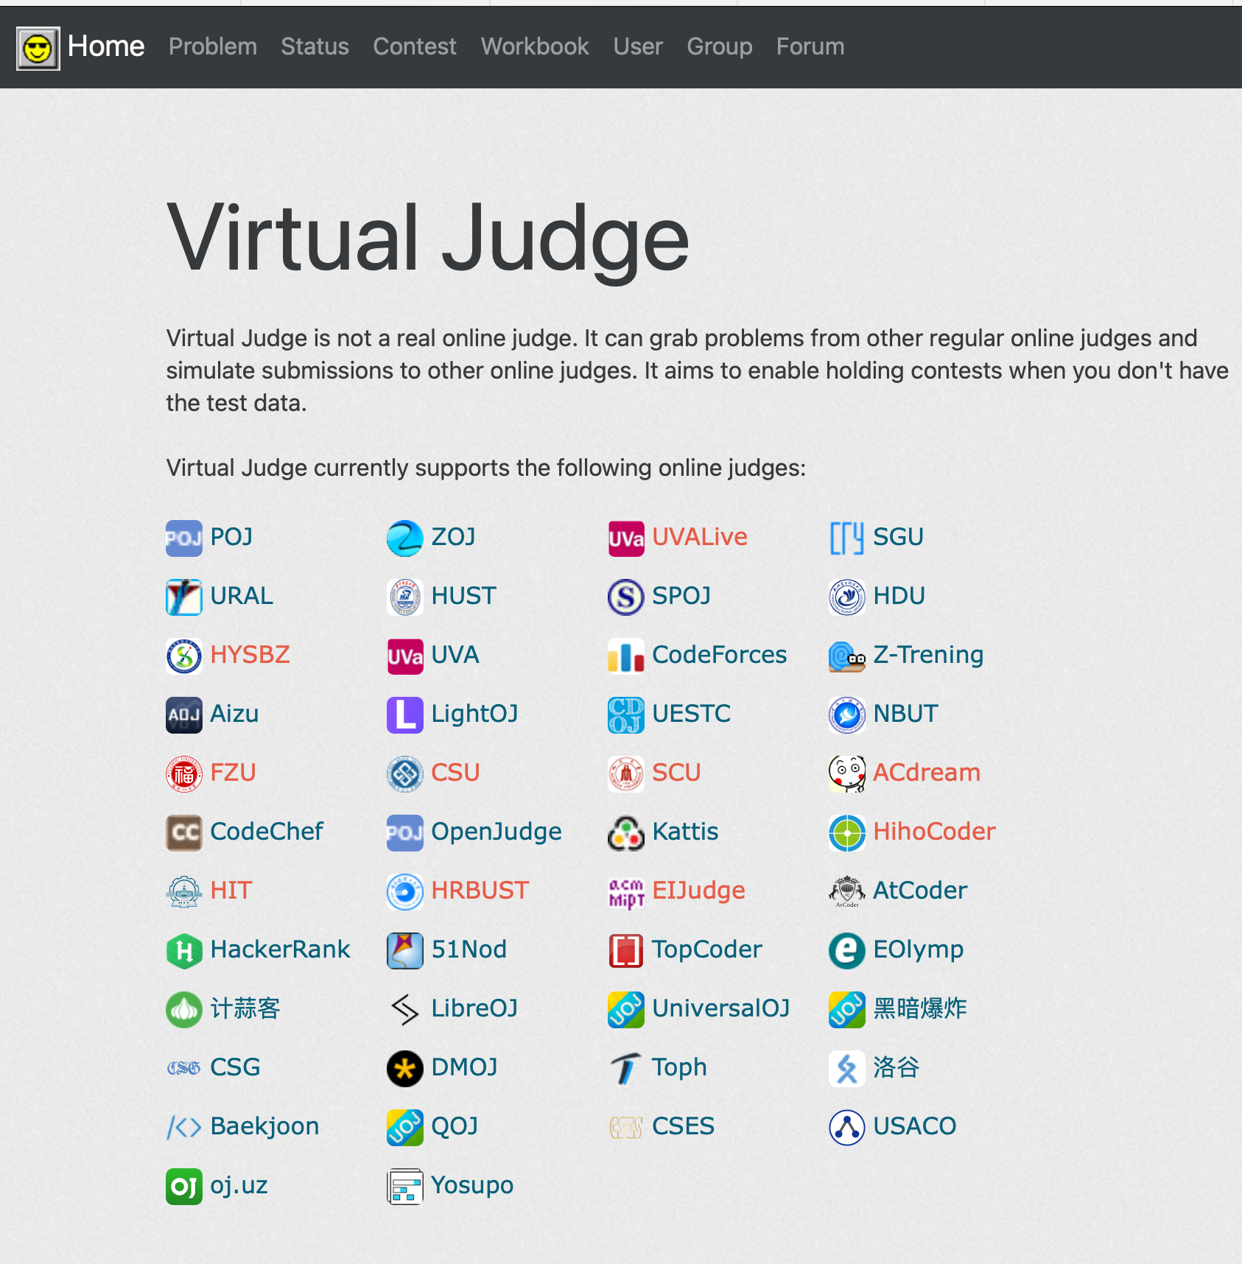
Getting on a judge
Sign up for Virtual Judge vjudge.net
You can access a large number of sites from there

Slide 5

Select UVA
You will have to get a login for tis site too

Slide 6

UVA

Slide 7

UVA

Slide 8
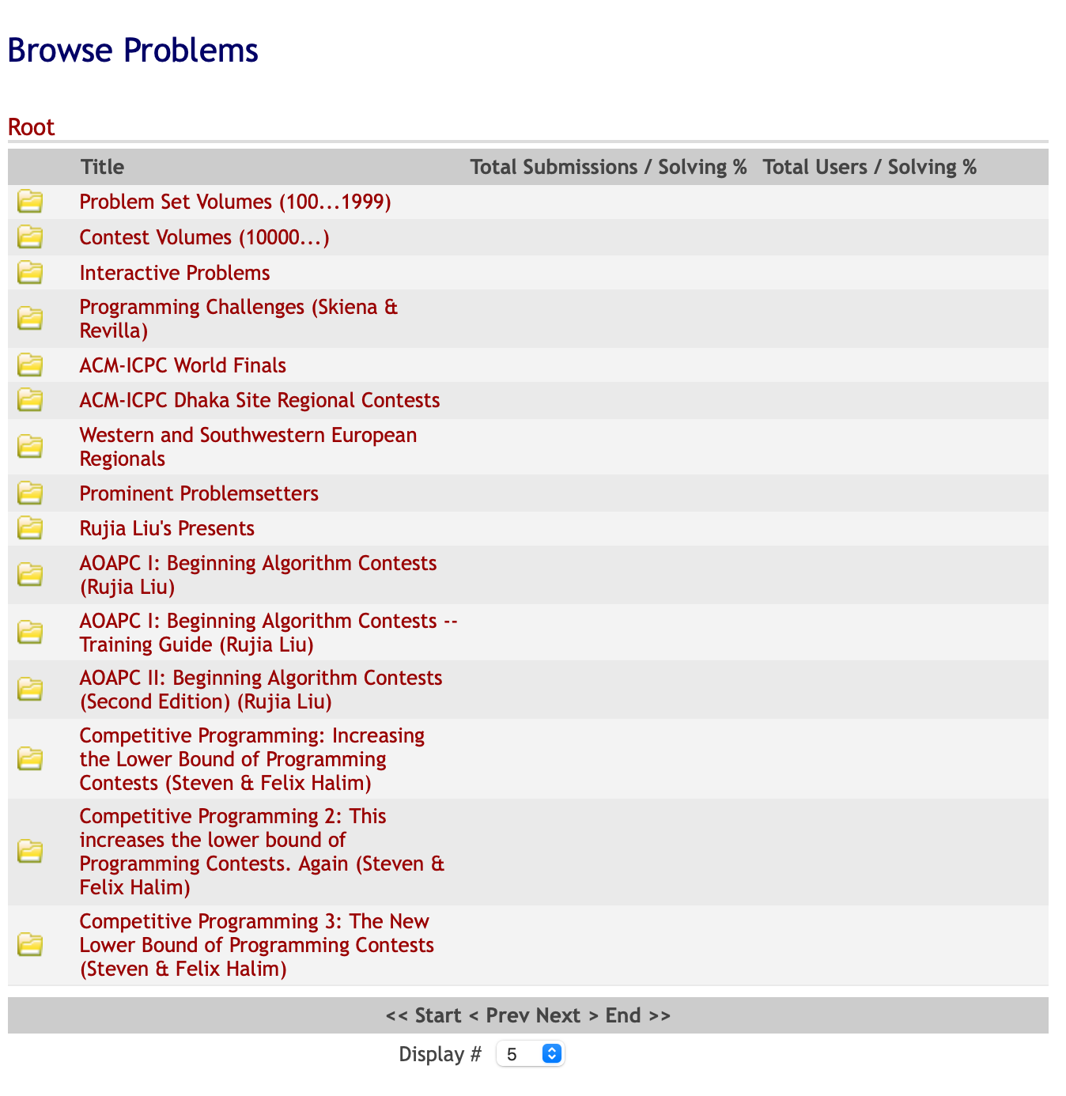


Problem Sets

Slide 9
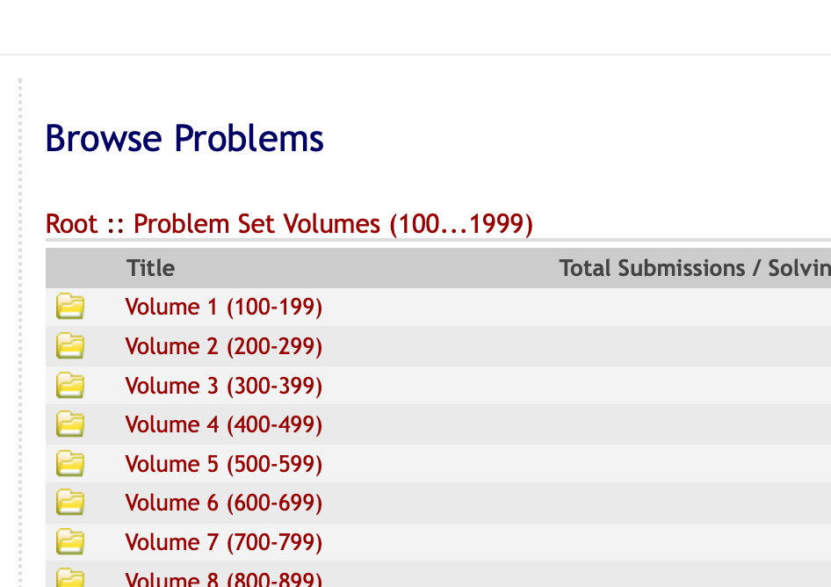
Problem Sets

Slide 10
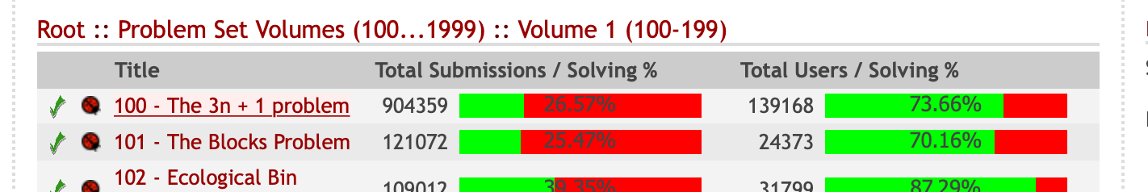
Problem Sets

Slide 11
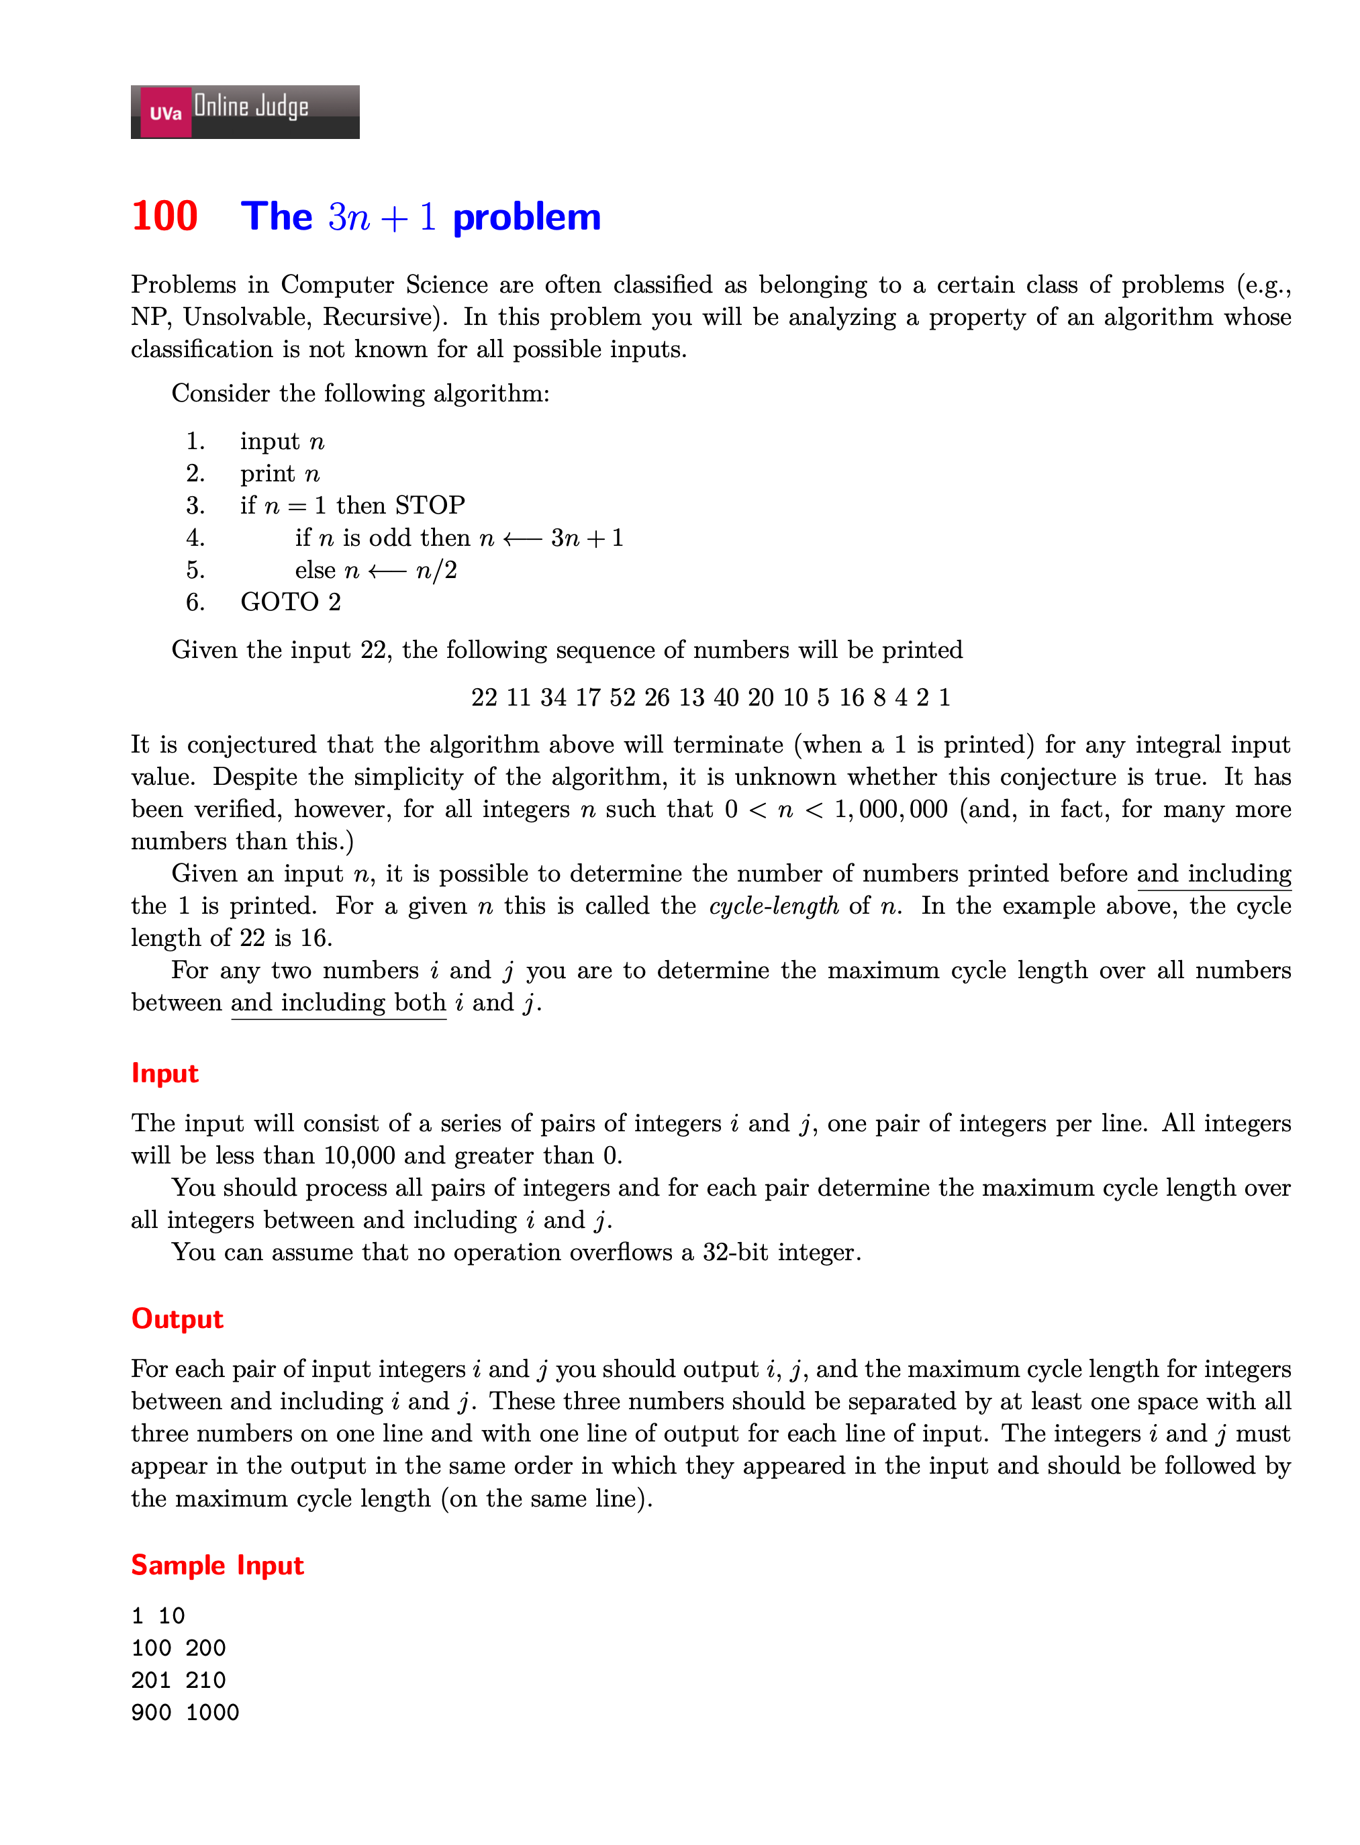

Slide 12
First – You must handle input
This is not Leetcode!
Your code will be tested with a lot of test cases by the judge
They will check all edge cases
Your code must read in values as defined in the problem description
When you test either you have to type this info in or use a trick I will explain

Slide 13
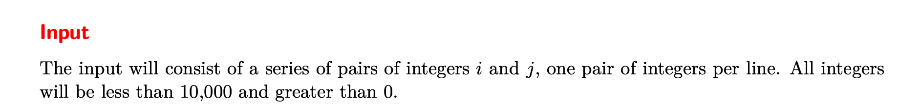
First – You must handle input
To read in two space seperated integers you use: scanf(“%d %d\n”,&i,&j)
#include<cstdio>
This explicitly reads in the integers (%d) and writes them to the variables previously declared
Note the reference required!!!
We are responsible for everything so we need to keep reading pairs in until there are no more pairs.
scanf returns the number of things read in so we can use a while loop as so:
while (scanf("%d %d\n",&m,&n)==2){ this is where the rest of the code goes}

Slide 14
C vrs C++
I just showed you how to read in integers and chars that could have various formatting and separations. I like the way that the c-style scanf works and uses much less code.
BUT
Strings are trickier
C uses char arrays which then are referenced by a char *. When you add a /0 to the end of the array it becomes a c-string. This requires creating a car array (example: char mystring[25]).
Instead will use std::getline which reads the entire line at one time
This is both a C and C++ function!
To read in multiple lines while(getline(std:: cin,myline)) { do something}

Slide 15
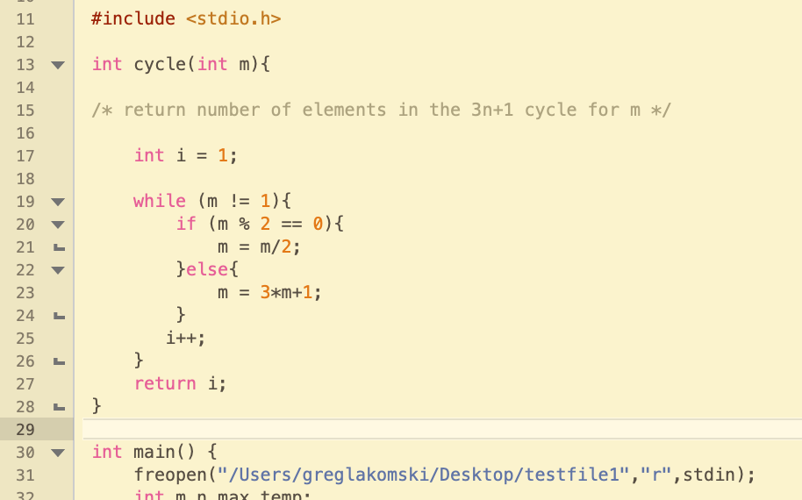
Testing
To TEST your code, create a test file (normally space seperated text) that mimics the sample input they give you and any other test cases you want to run.
call the file <something>.txt (that’s what I call all my files ☺)
The use freopen(only when you are testing – comment out before submitting) to run your test file as below.

Slide 16
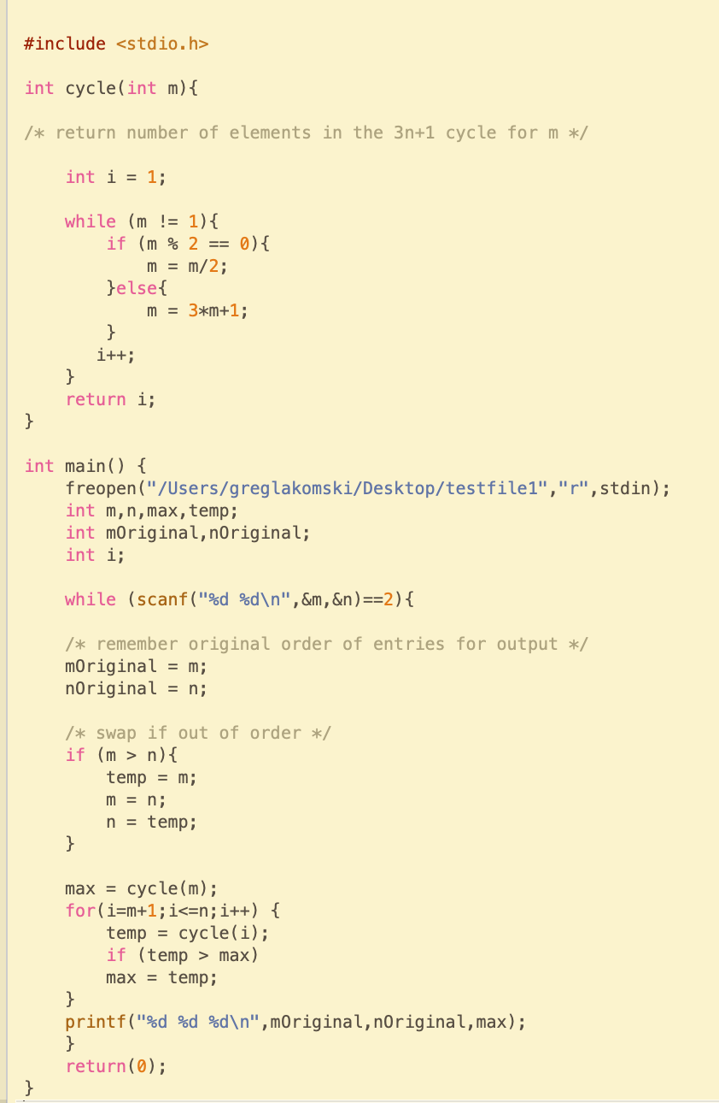

When you are finished testing, comment out freopen, click the submit button, paste in your code, and try it!
Try problem 100 with my code.
Make up a good test file and test a bunch of cases
Then submit, then break the code and submit
The make a loop or something that uses a lot of time and submit
Try to get rejected so you can see what happens

Slide 17
My submission was rejected☹
It is not correct
It took too long to run
Your code doesn’t work with some specific allowed case – like a divide by zero error you should have prevented
Remember, if they give you limits, you have to make sure to test EVERY SINGLE edge and any weird combination you can think of!!!!!!
If they don’t say they cannot do something you bet your a%* they will

Slide 18
Resources
https://competitive-programming.cs.princeton.edu/resources
There is a lot here but if you look down at the practicing problems section you will find the CSES practice problem site for beginners

Slide 19
That’s it for Now
If you have questions you can contact me at greg@txstate.edu
Make sure you start the subject “Question on CompCoding”
Tell me who you are and be clear about what you need
Greg

